Slide 1
^{Women’s}
^{Mental Health} ^{Training}
^{THINKING WELL,}
^{Living Well}
A Resource for Churches on Comprehensive Health Ministry

Slide 2
The NEW You
Written by
Millie Youngberg

Slide 3
One Woman’s Story…
Her long-time family doctor looked at her gravely and said, “The tests confirm what I’d suspected. You have diabetes. You are overweight and out of shape. Beth, you’ve got to get control of your life—now!”
Notes:
Beth had never been able to stick to a diet. Hardly able to walk, she’d never felt motivated to exercise either. Over the years she had moved from small to extra-large clothing sizes, periodically having no choice but to purchase a new wardrobe. She could hardly believe she had reached 225 pounds. At a medical check-up, her long-time family doctor looked at her gravely and said, “The tests confirm what I’d suspected. You have diabetes. You are overweight and out of shape. Beth, you’ve got to get control of your life—now!”
The probable medical outcomes for Beth if she continued her past life-style included stroke, blindness, kidney failure, circulatory problems, and even amputation of limbs. Beth was devastated, feeling that she’d been given a death sentence. When she arrived home, she automatically headed for the refrigerator for some “comfort food” when she ran into her husband. “What did the doctor tell you?” he asked.
“No more ice cream, sweets, potato chips, Cokes—all the things I like,” she admitted in tears. Realization hit. A new lifestyle change was vital.
It wasn’t easy. The whole family had a council and decided to join Beth on her new healthy-living journey. The first hurdle they tackled was diet. They decided that the easiest way to avoid eating junk food was not to buy it in the first place. The decision was: no more unhealthful, high-calorie, weight-buster snacks and desserts to tempt Beth and the family. Now when they opened the refrigerator, they found ready-cut vegetables instead of desserts and fat foods—and they were all the better for it!

Slide 4
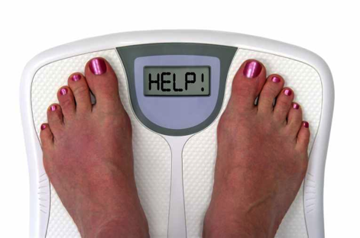
One Woman’s Story…
Overweight and obesity are advancing at epidemic rates in many countries and are major causes of diabetes and other high-risk diseases.
Notes:
Knowing that daily exercise was essential to Beth’s health, her husband bought her an exercise bicycle. (If she had been in another country it might have been a regular bicycle.) The next morning, Beth grudgingly began to use it. She was so out of shape that after a few minutes pedaling at a low setting, she was exhausted and gave up in defeat. While she sat on her soft recliner, winded and sweating, an inner voice seemed to speak to her: “Beth, you don’t have to lose all the extra pounds at once. Take them off pound by pound, minute by minute, step by step.” After a few reflective thoughts, she returned to the bicycle with fresh determination. I will spend the next five minutes of my life pedaling this bicycle, she thought. I’ll stick with my diet just one more meal. She also decided to eat less at each meal.
This new determination and way of looking at diet and exercise helped. All Beth had to do was make the right choices for just one more exercise session, one more meal. Sure enough, her daily cycling and better eating habits started to pay off. At her next doctor’s appointment, she weighed in 17 pounds (7.7 kg) lighter! She started to feel energized, and for the first time in her life she was in control. Beth felt like a changed person, with new dreams for a new healthy future. So did her family, who were tagging along with her, improving their lifestyle.
Overweight and obesity are advancing at epidemic rates in many countries and are major causes of diabetes and other high-risk diseases. Millions who are aware of this universal health risk are moving toward changing their eating and exercise habits and becoming new, healthier persons like Beth. It is a choice.

Slide 5
Becoming a New Person
If you are like most people, you’ll probably have to admit that right now, at this moment, you are not the person you want to be.
Notes:
Becoming a new person
If you are like most people, you’ll probably have to admit that right now, at this moment, you are not the person you want to be. Maybe you’ve somehow “settled” for the person you are, come to terms with what you see as “reality,” and given up on the kind of life you wanted to live. Let’s see if we can help you.

Slide 6
Getting Out of the Comfort Zone
What are the obstacles holding us back from becoming a new person—a healthier and happier person, an outstanding individual, one whom God wants to use in a special way.
Notes:
Getting out of the comfort zone
Why don’t we make changes in our lifestyle or develop useful skills even though it is our desire? On New Year’s Day we may write resolutions for new life practices: stop smoking, exercise five days a week, cut out afternoon snacks, or—the most popular resolution—go on a diet. Perhaps on any day of the year we may be impressed to change, to get out of our comfort zone, to look for a better job, to pursue higher education, or to volunteer in our local community. Perhaps we have a deep desire to do something no one has done before, something that seems totally impossible. Many have the desire to start a new spiritual journey with God. So with these desires, what keeps us from going forward to higher and higher levels of accomplishment?
What are the obstacles holding us back from becoming a new person—a healthier and happier person, an outstanding individual, one whom God wants to use in a special way, someone who will make a significant difference in the lives of others? Could they be barriers such as not enough self-control, or thoughts of “I’m OK as I am,” “I enjoy the status quo”? Might it be that you fear you can’t change, don’t have emotional energy to make a change, that you might fail, or that it just takes too much effort to change? What might keep you from making changes you desire?
Are you aware that habitual thought patterns may keep you from reaching your potential? What is it that really keeps you from going forward, doing the impossible, and accomplishing whatever in your inmost soul you want to do?

Slide 7
Blockers to Becoming the New You
Many want to change but fear that it is impossible. Fear can block the path to successfully accomplishing important goals and can be an obstacle to your success. We have good news!
Notes:
Blockers to becoming the New You
Many want to change but fear that it is impossible. Fear can block the path to successfully accomplishing important goals and can be an obstacle to your success. We have good news!

Slide 8
How can I conquer fear?
“Whenever I am afraid, I will trust in You….In God I have put my trust, I will not fear.” (Psalm 56:3,4)
“Perfect love casts out fear.” (1 John 4:18)
“For God has not given us a spirit of fear, but of power and of love and of a sound mind.” (2 Timothy 1:7)
Notes:
How can I conquer fear?
“Whenever I am afraid, I will trust in You….In God I have put my trust, I will not fear.” (Psalm 56:3,4)
“Perfect love casts out fear.” (1 John 4:18)
“For God has not given us a spirit of fear, but of power and of love and of a sound mind.” (2 Timothy 1:7)
Notice in these verses the relationship with God, who helps clear the way for us to become a New Person. God is there to encourage us to make good choices and do the impossible. He will remove the fear that blocks our progress. One person who has fearful thoughts immediately prays, “Lord, take away the fear. I choose to trust You.” And God answers her prayer.

Slide 9
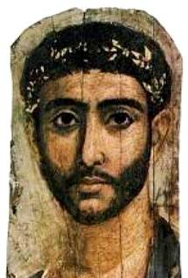
Biological Blockers
“As [a man] thinks in his heart, so is he.”
Proverbs 23:7
Notes:
Biological blockers
Biological factors may also be what block you from becoming a New You. Our physical health impacts our mind and may affect our choices. Factors involved may be: insufficient sleep, nutritional deficiencies, insufficient exercise and fresh air, and inadequate water intake. Or perhaps you need to take certain supplements. Vitamin B complex, and especially vitamin B1 (thiamine), help keep our nerves calm, memories keen, and our brains thinking straight. Fortunately vitamin B is readily available from eating whole grains. Deficiencies in vitamin B (thiamine) can cause memory problems, mood swings, irritability, and confusion.⁴
A combination of nutritious foods and appropriate supplements helps the brain, as do sufficient exercise, water, and fresh air. All of these help improve our emotions, our choices, and our total health. “As [a man] thinks in his heart, so is he.”
(Proverbs 23:7)

Slide 10
Biological Blockers
Negative thought patterns produce negative emotions and emotionally induced illnesses.
However, if a person decides to have victory over negative thinking, that choice can help improve one’s mood.
Notes:
The human brain has the power to rise above emotional moods. Negative thought patterns produce negative emotions and emotionally induced illnesses. A person may be in a “bad mood” and not make good choices because of some chemical imbalance in the brain. However, if a person decides to have victory over negative thinking, that choice can help improve one’s mood.

Slide 11
Biological Blockers
“O that every one might realize that he is the arbiter of his own destiny! Your happiness for this life, and for the future, immortal life, lies with yourself.”
Ellen G. White, Messages to Young People, p. 31
Notes:
One family educator said we can smile even though the heart be sad. Thoughts can create moods. Good positive thoughts can produce good moods. You can try self-talk like this: I will not let circumstances put me in a bad mood. I will make right choices that will help me be all that I can be with God’s help.
The human brain has a God-given ability not only to generate thoughts but also to exercise will-power to accept, reject, act on or not act on good or bad thoughts. You can still be a New You, make wise choices, and be the person you always wanted to be. You are the architect of your life.
“O that every one might realize that he is the arbiter of his own destiny! Your happiness for this life, and for the future, immortal life, lies with yourself.” (Ellen G. White, Messages to Young People, p. 31)

Slide 12
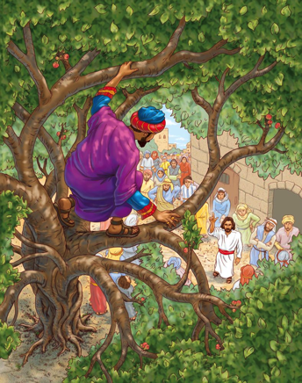
God’s Makeover of Zacchaeus
Never underestimate the power of a divine appointment that changes your life—that changes you into a new person.
Notes:
God’s makeover of Zacchaeus
Never underestimate the power of a divine appointment that changes your life—that changes you into a new person.
The Gospel of Luke tells of a shrewd businessman named Zacchaeus who seemed to have it all. He was the local tax collector, and rumor had it that not all of the money he took in made it into the government treasury. He probably owned a large and comfortable house and a hefty bank account. Yet, even though he was wealthy, Zacchaeus felt something was missing in his life. Here is his story from The Living Bible:
As Jesus was passing through Jericho, a man named Zacchaeus . . . tried to get a look at Jesus, but he was too short to see over the crowds. So he ran ahead and climbed into a sycamore tree beside the road, to watch from there.
When Jesus came by he looked up at Zacchaeus and called him by name! “Zacchaeus!” He said. “Quick! Come down! For I am going to be a guest in your home today!”
Zacchaeus hurriedly climbed down and took Jesus to his house in great excitement and joy. (Luke 19:1-6 (TLB))

Slide 13
God’s Makeover of Zacchaeus
Jesus announced,
“Today salvation [healing of brokenness] has come to this house.”
Luke 19:9 (NIV)
Notes:
Jesus announced, “Today salvation [healing of brokenness] has come to this house.” (Luke 19:9 (NIV))
Zacchaeus was so moved by Jesus’ offer of friendship that he repented of his dishonest ways and dedicated himself to helping the poor. He repaid four times as much money to each person he had overcharged for taxes to ensure he had made everything more than right.
Zacchaeus found a new dimension to his life after Jesus came to his house. One of the meanings of the ancient word for “salvation” is “to be made whole.” Wholeness had been restored to Zacchaeus’ home. He became a new person. What was so exciting about this was that when Jesus came to his house, the whole family changed. And that’s what this seminar is all about: bringing wholeness to the family, mending brokenness, and restoring its members to healthy relationships and right principles of living. In essence, it is fulfilling the lingering, unfulfilled dream. God had a makeover dream for Zacchaeus, and the time had come for a transformation in his life.

Slide 14
God is a Dreamer…
Let’s examine some Bible characters God had special plans for before they were conceived
Notes:
God is a Dreamer
Let’s examine some Bible characters God had special plans for before they were conceived. Some of the parents dedicated them to God before they were even born. Ultimately each of these discovered God’s big, unimaginable dream for their lives.

Slide 15
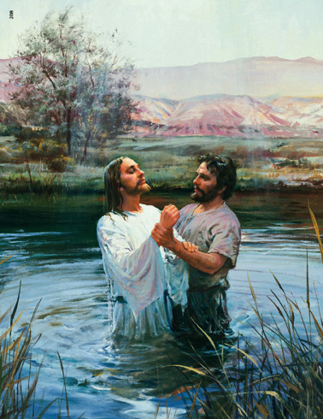
John the Baptist
“Among those born of women there is not a greater prophet than John the Baptist”
Luke 7:28
Notes:
John the Baptist
Before John was conceived, Gabriel, the highest angel, appeared to Zachariah and announced to this aged priest that a son would be born to him. He told him what to name the child and what work this son would perform, that he would announce to the nation the beginning of the ministry of Jesus.
It happened just that way. God’s dream became the dream of Zachariah and his wife, Elizabeth, and ultimately became the dream of their son. Even though John died alone in a prison, he fulfilled God’s dream. Jesus paid him the highest tribute: “Among those born of women there is not a greater prophet than John the Baptist.” (Luke 7:28)

Slide 16
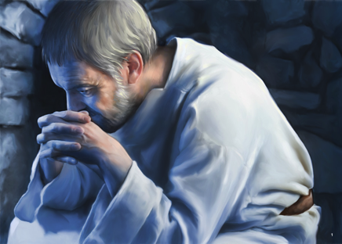
Jeremiah
“Before I formed you in the womb I knew you; before you were born I sanctified you; I ordained you a prophet to the nations.”
Jeremiah 1:5
Notes:
Jeremiah
The Bible prophet Jeremiah lived in one of the most difficult times in the history of a nation. He was needed to encourage and guide the people in a time of invasion, destruction, and exile. At the beginning of his work, God said, “Before I formed you in the womb I knew you; before you were born I sanctified you; I ordained you a prophet to the nations.”(Jeremiah 1:5) God had a dream for Jeremiah and announced it to him personally. It became the prophet’s own dream.

Slide 17
Activity
Recall a time when you had a divine appointment that changed your life and helped to make you a new person. Did it inspire you with a new dream? How? Share your story with someone.
Notes:
Recall a time when you had a divine appointment that changed your life and helped to make you a new person. Did it inspire you with a new dream? How? Share your story with someone.

Slide 18
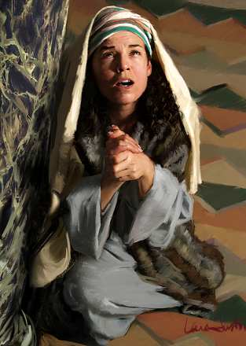
Samuel
God’s dream became Hannah’s dream, and through Samuel’s long and fruitful life he fulfilled that dream.
Notes:
Samuel
Hannah also discovered God’s dream for her. She had been childless and pleaded fervently that God would bless her and her husband with a son. She made a vow and dedicated her unborn child to the Lord for all the days of his life. When he was born, she named him Samuel, meaning “God heard” or “requested of God.” As a mere child Samuel heard God calling him, and the third time he heard the voice, coached by Eli the high priest, he responded, “Speak, for Your servant hears.” (1 Samuel 3:10)
Progressively he became the kind of new person God wanted him to be. Ultimately God used him to appoint the first two kings of Israel. Under divine direction, Samuel founded the school system that contributed to saving the nation from downfall for half a millennium. God’s dream became Hannah’s dream, and through Samuel’s long and fruitful life he fulfilled that dream.

Slide 19
Your Dream
The greatest dreams don’t originate inside you; the life-changing dreams come from the God of the universe.
Notes:
Your dream
The greatest dreams don’t originate inside you; the life-changing dreams come from the God of the universe. Our success in life will depend upon the degree to which we discover God’s dream for us and our faithfulness in pursuing it once we have discovered God’s plan. God tailors the dream to our own uniqueness, recognizing how we can contribute to the world in some special way, since only He knows just what we can accomplish through His power. But if we don’t discover God, we won’t discover God’s dream. And because of God’s gift of choice we don’t have to respond to His desires for our lives. It is our choice. God’s dream for each of us is not a once-in-a-lifetime event, but a continual growth in becoming a New You under His training and polishing.
There are times that Father God has to do a makeover job before His dream plan is carried out to its fullest in our lives. He did that for Abram who became Abraham, Jacob who became Israel, and Saul who became Paul, and He will do it for us today.

Slide 20
God’s Dream Plan for You
What great idea, dream, desire has been planted in your heart and mind?
What is God nudging you to do for Him and for yourself?
Notes:
God’s dream plan for you today
Is God nudging you to do something special in your life for Him? Do you have a clue as to what it might be?
What great idea, dream, desire has been planted in your heart and mind?
What is God nudging you to do for Him and for yourself?

Slide 21
Are you ready for the faith journey into new challenges—new horizons, a New You?
Your makeover under God’s design can start at any age and any time. Are you ready?
Notes:
Are you ready for the faith journey into new challenges—new horizons, a New You?
Your makeover under God’s design can start at any age and any time. Are you ready?
By having a positive relationship with God, you start a new adventure. Go forward. When you follow a heaven-born idea, the dream unfolds. Listen in the early morning hours as God whispers directions to you and reveals new dimensions of your dream.

Slide 22
Ray’s Moment of Inspiration
Notes:
Ray’s moment of inspiration
The day that began a chain of lifestyle choices was a monumental day for Ray. That day, looking at a photograph of himself, Ray realized he was overweight, out of shape, and looked unkempt in his sloppy clothes. It did not make him very happy. He decided that no one else was to see the photo.
But then it hit him. Everyone sees me this way every day. This is the way I really look. Reality struck. I’m not taking care of my body. My life is out of control. I need to do something about it. I really don’t want to change, but . . . I have to.
Making this change would be a challenge, he realized. While thinking about adjusting his lifestyle, he saw that life is like a movie. If I could fast-forward to twenty years from now, what would I look like, what would I feel like, if I don’t change now? Will I be healthy, or ill like my parents? For the sake of my health and profession, the time has come for me to do something about this, starting today.
At that inspirational moment, Ray became aware that if he were to achieve his lifelong goals, he must improve his eating habits. While processing his thoughts, he made a decision: I must be more disciplined in my daily choices. I can do it. I can break old patterns.

Slide 23
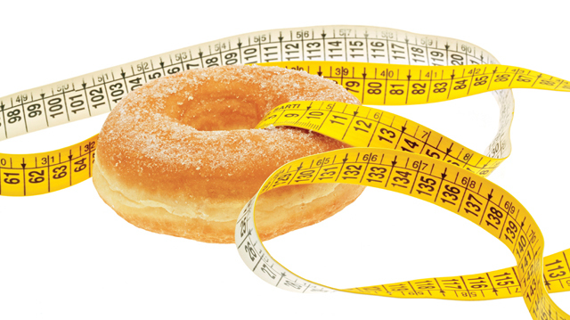
Ray’s Moment of Inspiration
Notes:
Ray decided to take action right away and started a new health improvement program—going to the gym to work out, eating healthful foods, drinking eight glasses of water a day, and being positive in his outlook. He ate less at mealtimes, avoiding lots of fats he had been accustomed to eating, and bit by bit the pounds came off. To get more exercise, Ray began taking walks each evening, regardless of the weather.
When he found himself backsliding on his diet plan, Ray took a nutrition class in his community. He began to focus on eating nutritious meals—fresh produce, no processed meats, more whole grains, fruits, and nuts. Ray struggled to vary his vegetables. His taste buds were not quite ready for the healthful greens, but he started by eating a small quantity. When there was a celebration such as Grandma’s birthday party, he participated by eating small portions of sweets.
Ray realized this new journey was for life and was an ongoing lifestyle commitment. He was in earnest about his makeover. Finally, with his weight loss, new wardrobe, and trim haircut, Ray was ready for a job interview at a firm looking for a marketing consultant. And he got the job!
His professional dreams and lifestyle goals were being realized, and he praised God, who had helped make his dreams come true. Ray now had more energy, was healthier, happier, and enjoyed a keener mind. He was ready to go forward facing the new challenges of life. There are many stories just like Ray’s. Perhaps yours is one of them—or will be.

Slide 24
God’s Dream Plan for You
God has a dream for all of us to reach our potential.
Notes:
God has a dream for all of us to reach our potential. However, research shows that many with high intelligence do not reach theirs: one-third attain high levels in their professional performance, one-third stay in the average range, and one-third are at a low level of contributing to society. Why? Did one-third give up? Were they willing to tolerate mediocrity? Were they not willing to stretch their powers and get out of their comfort zone to reach higher levels?
What are your present dreams? To get a better education? To get a better job? To be more attractive? To improve your health by eating right and exercising daily? To be a more loving spouse? To improve a relationship with family and others? To meet other people’s needs? To serve the Lord?
Think back over your life, and no doubt you will see many instances where things “just worked out perfectly.” If you start searching for your unique purpose in life with intentionality, you will see instances where God works behind the scenes to help you realize your dreams. He’ll put you in the right place at the right time. He’ll give you new knowledge and direct your path with His guidance. He will set up divine appointments with the right people. He will make a way when there is no way for the dream to come true—when everyone you know says, “Impossible.”

Slide 25
God’s Dream Plan for You
What will God do to make your dreams come true? The short answer is: anything necessary.
Notes:
God’s storehouse for dreamers has infinite supplies—and limitless access! Sometimes we limit these blessings by not asking God for help, through our preference to remain in a rut, doing the same things we have done for years. Have you noticed that God sometimes allows pressures to force us to move forward out of our comfort zone? Have you noticed that struggles and challenges strengthen our faith as we go forward?
We must move out of the safe zone and leap into the faith zone. We must stretch our thoughts and our minds. This enlarges our abilities and skills. When we reach up high, miracles are ahead!
What will God do to make your dreams come true? The short answer is: anything necessary.
There is much research indicating that a new lifestyle—which includes exercising thirty minutes five or six times a week, drinking six to eight glasses of water daily, eating veggies and fruits, and being a positive person—results in drastically improved health. It will probably prevent between 50 and 80 percent of catastrophic diseases. So why wait? Start on the New You journey by adopting a new lifestyle.
Most of us want to enjoy lifestyle victories. But it’s not our power that makes this happen—it is God’s power. If we do our best, God will do the rest. The changes may include being more interesting, being more kind, patient and loving, being more hopeful and caring. The New You will want to take optimum care of this marvelous body God has given and to grow stronger in muscle, mind, and abilities.

Slide 26
God’s Dream Plan for You
God is the Dream Maker. Our relationship with Him ignites our dream.
Notes:
God has big plans for your life. He is willing to give you the desires of your heart. God wants you to be the amazing person you dream of being. But remember that God won’t force an entrance into your life. He’s not going to have a telemarketer call you. You can’t charge the new dream to your credit card. You can’t mend brokenness without effort. That won’t happen. It is not a matter of buying something, but of befriending Someone in a personal relationship. His coming into your life depends on you opening the door every day to an exciting relationship with Him. The psalmist David says, “May He grant your heart’s desire and fulfill all your plans.” (Psalm 20:4)
Inside every person is a sense that she can be more than she is, and a driving desire to change. Redemption gives the free gift of restoration to the “you” that you can be—God’s New You!
God is the Dream Maker. Our relationship with Him ignites our dream.
For you to be a new person and become a New You is a challenge. It isn’t easy, but it’s worthwhile. It is our choice to make, but we don’t have to do it alone. A promise many of us can claim when the temptations of life are strong, tasks are difficult, or an impossible habit has to be broken, is: “I can do all things through Christ who strengthens me.” (Philippians 4:13)
Many stories in the Bible tell us about people who had serious faults and broke God’s commandments, including Jacob, Moses, Gideon, David, and Peter. But by God’s grace and His miraculous power, they left the old person behind and became a New Person for the glory of God. Doesn’t this bring hope to our hearts as we walk along our spiritual pathway of life? You also can choose a new direction.

Slide 27
The Old is Gone, New Life Begins
“If anyone is in Christ, he is a new creation. God has big plans for your life. The old life is gone. A new life has begun!”
2 Corinthians 5:17
Notes:
The old is gone, new life begins
Are you struggling spiritually? Are the sins of society ruling your life? Are your vital forces going downhill because of bad choices? Do you need a miracle to get you into a safer environment or on the path to real, positive, healthful living? What you need is the guidance and help of your Forever Friend. You need Jesus. All you have to do is to open the door and invite Him into your life. The Bible says: “If anyone is in Christ, he is a new creation. God has big plans for your life. The old life is gone. A new life has begun!” (2 Corinthians 5:17 (NLT))
That’s the real New You. “Old things have passed away; . . . all things have become new.” Will you accept Him now? Will you let Christ come into your life? He wants to be your guide, your strength, and your Forever Friend.
If you are beginning on a pathway to a New You and desire God’s guidance, quietly tell Jesus that you choose Him as the Lord of your life, and ask Him to forgive your sins. Jesus will help you do a spiritual life makeover, which will start you on an exciting and exhilarating journey. Is that your choice?

Slide 28
A Prayer
Heavenly Father, I thank You that You are the Dream Giver and the Dream Maker. I want to be a new person and submit all my dreams to you. You know what is best for me. I know you want to help me achieve my potential.
Notes:
A Prayer
Heavenly Father, I thank You that You are the Dream Giver and the Dream Maker. I want to be a new person and submit all my dreams to you. You know what is best for me. I know you want to help me achieve my potential.

Slide 29
Please help me to be more like You, choose a healthy lifestyle, and have a positive relationship with my family and others. Change me so that I can be all that You want me to be as a new person and reach out in incredible ways to help others. Guide by Your victorious hand so that Your dreams for me may come true.
In Jesus’ name, Amen.
Notes:
Please help me to be more like You, choose a healthy lifestyle, and have a positive relationship with my family and others. Change me so that I can be all that You want me to be as a new person and reach out in incredible ways to help others. Guide by Your victorious hand so that Your dreams for me may come true. In Jesus’ name, Amen.

Slide 30
Reflect and Discuss
In small groups read the questions in your Handout and share your thoughts, feelings or experiences if you wish.
Notes:
In small groups read the questions in your Handout and share your thoughts, feelings or experiences if you wish.

Slide 31
Prayer
“Therefore, if anyone is in Christ, the new creation has come: The old has gone, the new is here!”
2 Corinthians 5:17
Notes:
Prayer
“Therefore, if anyone is in Christ, the new creation has come: The old has gone, the new is here!” 2 Corinthians 5:17

